Slide 1
Circuit Theory & Analysis
Three Phase Balanced Star-Connected Load

Slide 2
Three Phase Circuits
Balanced Three Phase
Star-Connected Load
Circuit Theory & Analysis

Slide 3
Objectives
  Understand the characteristics of a
  balanced star connected load.
  Derive the relationship for line voltage,
  phase voltage, line current, phase
  current, neutral current, power factor
  and real power.
Circuit Theory & Analysis
Notes:
Student should be able to:
Draw and explain the characteristics of a balanced star−connected load. Relationship between line current and phase current line voltage and phase voltage.
Draw Phasor diagrams for both lagging and leading power factor loads
Solve problems on balanced star load.

Slide 4
3-φ balanced supply connected to
3-φ 4-wire star-connected load
A
Y-connected
balanced supply. N' of
supply connected to
N of load
I_{A}
V_{AN}
⎮Z_{A}⎮∠φ_{A}
I_{N}
N'
N
⎮Z_{C}⎮∠φ_{C}
⎮Ζ_{B}⎮∠φ_{B}
I_{C}
C
V_{BN}
I_{B}
V_{CN}
B
Z_{A} is the complex impedance of the A phase with⎮Z_{A}⎮ being the magnitude of Z_{A} and φ_{A} the impedance angle of Z_{A}. e.g. Z_{A} = ⎮Z_{A}⎮∠φ_{A} = 10 ∠25° Ω
Similarly for the other two complex impedances.
Circuit Theory & Analysis

Slide 5
3-φ balanced supply connected to
3-φ 4-wire star-connected load
A
Y-connected
balanced supply. N' of
supply connected to
N of load
I_{A}
V_{AN}
⎮Z_{A}⎮∠φ_{A}
I_{N}
N'
N
⎮Z_{C}⎮∠φ_{C}
⎮Ζ_{B}⎮∠φ_{B}
I_{C}
C
V_{BN}
I_{B}
V_{CN}
B
From Kirchhoff's current law
I_{A} + I_{B} + I_{C} + I_{N} = 0 (vector equation)
Circuit Theory & Analysis

Slide 6
3-φ balanced supply connected to
3-φ 4-wire star-connected load
A
Y-connected
balanced supply. N' of
supply connected to
N of load
I_{A}
V_{AN}
⎮Z_{A}⎮∠φ_{A}
I_{N}
N'
N
⎮Z_{C}⎮∠φ_{C}
⎮Ζ_{B}⎮∠φ_{B}
I_{C}
C
V_{BN}
I_{B}
V_{CN}
B
The supply phase voltages are also the load phase voltages.
The line currents are also the load phase currents.
But line voltage , say V_{AB}, is not equal to load
phase voltage, say V_{AN}.
Circuit Theory & Analysis

Slide 7
3-φ balanced supply connected to
3-φ 4-wire star-connected load
A
I_{A}
V_{AN}
⎮Z_{A}⎮∠φ_{A}
I_{N}
N'
N
⎮Z_{C}⎮∠φ_{C}
⎮Ζ_{B}⎮∠φ_{B}
I_{C}
C
V_{BN}
I_{B}
V_{CN}
B
To find the line currents, the 3-phase circuit can be treated like 3 single-phase circuits.
Circuit Theory & Analysis

Slide 8
3-φ balanced supply connected to
3-φ 4-wire star-connected load
A
I_{A}
V_{AN}
⎮Z_{A}⎮∠φ_{A}
I_{N}
N'
N
I_{A} = V_{AN} / ⎮Z_{A}⎮∠φ_{A}
Circuit Theory & Analysis

Slide 9
3-φ balanced supply connected to
3-φ 4-wire star-connected load
I_{N}
N'
N
⎮Ζ_{B}⎮∠φ_{B}
V_{BN}
I_{B}
B
I_{B} = V_{BN} / ⎮Z_{B}⎮∠φ_{B}
Circuit Theory & Analysis

Slide 10
3-φ balanced supply connected to
3-φ 4-wire star-connected load
I_{N}
N'
N
⎮Z_{C}⎮∠φ_{C}
I_{C}
C
V_{CN}
I_{C} = V_{CN} / ⎮Z_{C}⎮∠φ_{C}
Circuit Theory & Analysis

Slide 11
3-φ balanced supply connected to
3-φ 4-wire star-connected load
A
I_{A}
V_{AN}
⎮Z_{A}⎮∠φ_{A}
I_{N}
N'
N
⎮Z_{C}⎮∠φ_{C}
⎮Ζ_{B}⎮∠φ_{B}
I_{C}
C
V_{BN}
I_{B}
V_{CN}
B
I_{A} = V_{AN} / ⎮Z_{A}⎮∠φ_{A}, I_{B} = V_{BN} / ⎮Z_{B}⎮∠φ_{B} and I_{C} = V_{CN} / ⎮Z_{C}⎮∠φ_{C}
If V_{AN} = 25 ∠0°, then
V_{BN} = 25 ∠-120° and
V_{CN} = 25 ∠-240° or = 25 ∠120° volts
Circuit Theory & Analysis
Notes:
If the loads are balanced, then the magnitude of all the line currents are the same but their angles are 120 degrees apart.

Slide 12
Power consumption of 3-φ 4-wire star-connected load
A
I_{A}
V_{AN}
⎮Z_{A}⎮∠φ_{A}
I_{N}
N'
N
⎮Z_{C}⎮∠φ_{C}
⎮Ζ_{B}⎮∠φ_{B}
I_{C}
C
V_{BN}
I_{B}
V_{CN}
B
Power across each phase can be dealt with
individually
Circuit Theory & Analysis

Slide 13
Power consumption of 3-φ 4-wire star-connected load
A
I_{A}
V_{AN}
⎮Z_{A}⎮∠φ_{A}
I_{N}
N'
N
Power =
⎮V_{AN}⎮x ⎮I_{A}⎮ x cos (angle between V_{AN} & I_{A})
Circuit Theory & Analysis
Notes:
Angle between V_{RN} & I_{R} is also the impedance angle of Z_{R}

Slide 14
Power consumption of 3-φ 4-wire star-connected load
I_{N}
N'
N
⎮Ζ_{B}⎮∠φ_{B}
V_{BN}
I_{B}
B
Power =
⎮V_{BN}⎮ x ⎮I_{B}⎮ x cos (angle between V_{BN} & I_{B})
Circuit Theory & Analysis
Notes:
Angle between V_{YN} & I_{Y} is also the impedance angle of Z_{Y}

Slide 15
Power consumption of 3-φ 4-wire star-connected load
I_{N}
N'
N
⎮Z_{C}⎮∠φ_{C}
I_{C}
C
V_{CN}
Power =
⎮V_{CN}⎮ x⎮I_{C}⎮ x cos (angle between V_{CN} & I_{C})
Circuit Theory & Analysis
Notes:
Angle between V_{BN} & I_{B} is also the impedance angle of Z_{B}

Slide 16
Power consumption of 3-φ 4-wire star-connected load
A
I_{A}
V_{AN}
⎮Z_{A}⎮∠φ_{A}
I_{N}
N'
N
⎮Z_{C}⎮∠φ_{C}
⎮Ζ_{B}⎮∠φ_{B}
I_{C}
C
V_{BN}
I_{B}
V_{CN}
B
Total Power =
⎮V_{AN}⎮ x ⎮I_{A}⎮ x cos (angle between V_{AN} & I_{A})
+ ⎮V_{BN}⎮ x ⎮I_{B}⎮x cos (angle between V_{BN} & I_{B})
+ ⎮V_{CN}⎮ x ⎮I_{C}⎮x cos (angle between V_{CN} & I_{C})
Circuit Theory & Analysis

Slide 17
Power consumption of 3-φ 4-wire star-connected load
A
I_{A}
V_{AN}
⎮Z_{A}⎮∠φ_{A}
I_{N}
N'
N
⎮Z_{C}⎮∠φ_{C}
⎮Ζ_{B}⎮∠φ_{B}
I_{C}
C
V_{BN}
I_{B}
V_{CN}
B
When the supply is balanced and the three phases of the load are identical (3-φ balanced load), then
⎮ Z_{A} ⎮ = ⎮ Z_{B} ⎮ = ⎮ Z_{C} ⎮ = ⎮ Z ⎮
and φ_{A} = φ_{B} = φ_{C} = φ
Circuit Theory & Analysis

Slide 18
Power consumption of 3-φ 4-wire balanced star-connected load
A
I_{A}
V_{AN}
⎮Z_{A}⎮∠φ_{A}
The three impedances are identical.
I_{N}
N'
N
⎮Z_{C}⎮∠φ_{C}
⎮Ζ_{B}⎮∠φ_{B}
I_{C}
C
V_{BN}
I_{B}
V_{CN}
B
⎮V_{AN}⎮=⎮V_{BN}⎮=⎮V_{CN}⎮= V_{PH} ,
⎮I_{A}⎮=⎮I_{B}⎮=⎮I_{C}⎮= I_{L} ,
( V_{AN} ^ I_{A} ) = ( V_{BN} ^ I_{B} ) = ( V_{CN} ^ I_{C} ) = φ,
Circuit Theory & Analysis

Slide 19
Power consumption of 3-φ 4-wire balanced star-connected load
Total Power =
⎮V_{AN}⎮ x ⎮I_{A}⎮ x cos (angle between V_{AN} & I_{A})
+ ⎮V_{BN}⎮ x ⎮I_{B}⎮ x cos (angle between V_{BN} & I_{B})
+ ⎮V_{CN}⎮ x ⎮I_{C}⎮ x cos (angle between V_{CN} & I_{C})
becomes, for balanced loads,
Total Power
= V_{PH} I_{PH} cos φ + V_{PH} I_{PH} cos φ + V_{PH} I_{PH} cos φ
= 3 V_{PH} I_{PH} cos φ
Circuit Theory & Analysis

Slide 20
Power consumption of 3-φ 4-wire balanced star-connected load
In a star- connected system ,
I_{L} = I_{PH} and V_{L} = √3 x V_{PH}, then..........
Total Power = 3 V_{PH} I_{PH} cos φ
= 3 ( V_{L} / √3 ) I_{L} cos φ
= √3 V_{L} I_{L} cos φ
Circuit Theory & Analysis

Slide 21
Phasor diagram for a balanced star-connected load
V_{CN}
ω
120°
V_{AN}
120°
V_{BN}
The load phase voltages V_{AN}, V_{BN} and V_{CN} have the same magnitude but differ from each other by 120° in the ABC sequence.
Circuit Theory & Analysis

Slide 22
Phasor diagram for a balanced star-connected load
V_{CN}
ω
120°
V_{AN}
φ
120°
I_{A}
V_{BN}
The load phase currents I_{A} (which is also the line current) lags behind its respective phase voltage V_{AN} by an angle φ, if the load impedance is inductive
Circuit Theory & Analysis

Slide 23
Phasor diagram for a balanced star-connected load
V_{CN}
I_{C}
ω
φ
120°
V_{AN}
φ
I_{B}
120°
I_{A}
φ
V_{BN}
I_{A}, I_{B} and I_{C} have the same magnitude and displaced from each other also by 120°.
Circuit Theory & Analysis

Slide 24
Phasor diagram for a balanced star-connected load
V_{CN}
I_{C}
ω
φ
120°
V_{AN}
φ
I_{B}
120°
I_{A}
φ
V_{BN}
I_{A}, I_{B} and I_{C} have the same magnitude and displaced from each other also by 120°.
Therefore, I_{A} + I_{B} + I_{C} = 0 (vector equation)
or the vectors I_{A}, I_{B} and I_{C} form a closed triangle
Circuit Theory & Analysis

Slide 25
3-φ, 4-wire, balanced star-connected load
A
I_{A}
V_{AN}
⎮Z_{A}⎮∠φ_{A}
I_{N}
N'
N
⎮Z_{C}⎮∠φ_{C}
⎮Ζ_{B}⎮∠φ_{B}
I_{C}
C
V_{BN}
I_{B}
V_{CN}
B
I_{A} + I_{B} + I_{C} + I_{N} = 0 (by KCL)
but with
I_{A} + I_{B} + I_{C} = 0 for balanced load, then I_{N} must therefore equal to zero,
showing that the neutral wire carries no current and is therefore not required for balanced load.
Circuit Theory & Analysis
Notes:
Becomes 3 phase 3 wire system

Slide 26
Example 2.2
A three-phase three-wire 199 V ABC supply system feeds a balanced Y-connected load, with a phase impedance of Z = 23 ∠30º Ω. Taking V_{AN} as the reference voltage, find the line currents and draw the phasor diagram.
Circuit Theory & Analysis

Slide 27
Example 2.2
Solution: Here the line-to-line voltage magnitude, V_{L} , in rms value, is 199 V. As the supply and the load are both balanced, the load phase voltages must also be balanced with
V_{PH} = V_{L} / √3 = 199 / √3 = 114.9 V
Circuit Theory & Analysis

Slide 28
Example 2.2
Solution: Taking V_{AN} as the reference so that V_{AN} = 114.9 ∠0⁰ V, then
I_{A} = V_{AN} / Z
= 114.9 ∠0^{ο} / 23 ∠30^{ο}
= 5 ∠−30^{ο} A
Circuit Theory & Analysis

Slide 29
Example 2.2
Solution: Because this is a ABC system and that the load and supply are both balanced, so to find I_{B} and I_{C}, it is not necessary to repeat the above calculation. Just write :-
I_{B} = 5 ∠−30^{ο} − 120^{ο} = 5 ∠−150^{ο} A and
I_{C} = 5 ∠−150^{ο} −120^{ο} = 5 ∠−270^{ο} = 5 ∠90^{ο} A
Circuit Theory & Analysis
Notes:
All line currents are equal in magnitude and lagging by 120º apart.

Slide 30
Example 2.2
V_{AB}=199V
Phase
sequence
ABC
V_{CN}
ω
V_{CA}
30^{O}
120^{O}
30^{O}
V_{AN}=114.9 V
120^{O}
V_{AB} = 199∠0°+ 30° V
= 199∠30° V
V_{AN} = 114.9∠0° V
V_{BN}
V_{BN} = 114.9 ∠−120° V
V_{BC} = 199∠−90° V
V_{CN} = 114.9∠−240°or
= 114.9∠120°
V_{BC}
V_{CA} = 199∠−210° V
Circuit Theory & Analysis
Notes:
Phase voltages – 120 degree apart.
Line voltage leads phase voltage by 30 degree.
Line voltages – 120 degree apart.

Slide 31
Example 2.2
Phase
sequence
ABC
I_{C}
V_{AB}=199V
V_{CN}
ω
V_{CA}
30^{O}
30^{O}
120^{O}
30^{O}
120^{O}
V_{AN}=114.9 V
30^{O}
I_{B}
30^{O}
I_{A}=5 A
I_{A} = 5∠−30° Α
V_{BN}
I_{B} = 5∠−150° Α
I_{C} = 5∠90° Α
V_{BC}
Circuit Theory & Analysis
Notes:
Phase voltages – 120 degree apart.
Line voltage leads phase voltage by 30 degree.
Line voltages – 120 degree apart.

Slide 32
Example 2.3
Each phase of star connected load consists of a resistance of 100 Ω in parallel with a capacitor of capacitance 31.8 μF. Calculate the line currents, the power absorbed and the power factor when connected to a 416 V, 3-phase, 50 Hz supply. Take V_{BC} as reference.
Circuit Theory & Analysis

Slide 33
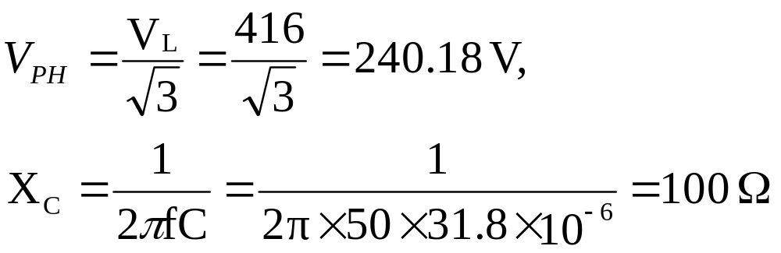
Example 2.3
Solution: Given:-
V_{L} = 416V, V_{BC} = 416∠0⁰ V, f = 50 Hz,
R_{L} = 100 Ω ; C = 31.8 μF,
Circuit Theory & Analysis

Slide 34
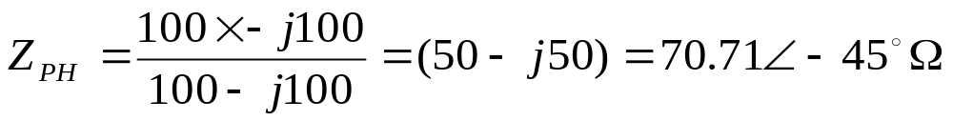
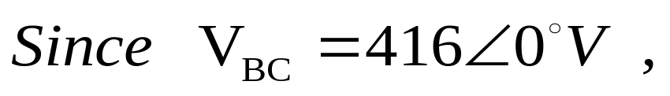
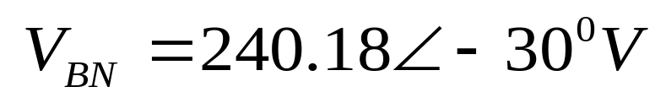
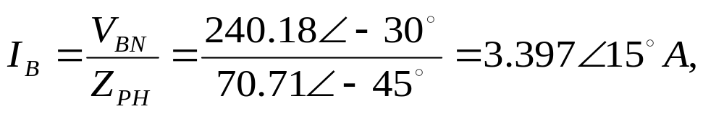

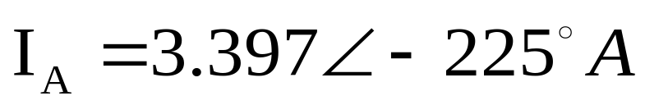
Example 2.3
Solution:
Circuit Theory & Analysis

Slide 35
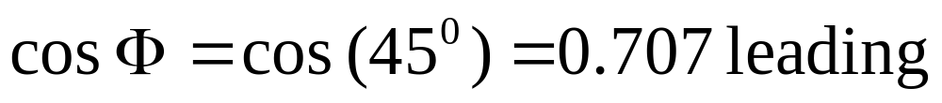
Example 2.3
Solution:
Total Power = 3 V_{PH} I_{PH} cos φ
= 3 (240.18) (3.397) 0.707
= 1.731 kW
Circuit Theory & Analysis

Slide 36
Balanced Delta-Connected Load
Lee M L
Office: T12A522
School of EEE
Tel: 6879-0657

